Slide 1
community detection

Slide 2
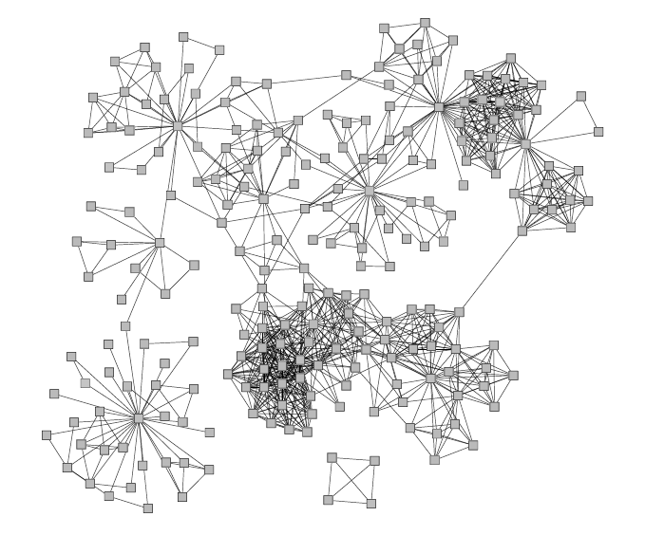
Example
Network of co-authorships in a university department
The problem of finding groups of nodes is called community detection.

Slide 3
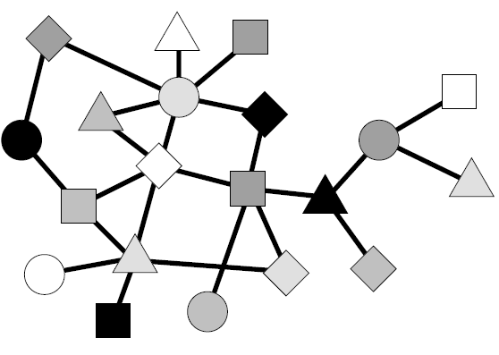
Possible Application: Visualization
Visualization of network structure using community detection: each community is represented by a single large node.

Slide 4
Approaches to Community Detection
Informally:
Given a network, divide it into groups of nodes, called communities, such that such that there are many edges within groups and few edges between them.
What exactly do we mean by “many” and “few”?
Major approaches:
definition in terms of modularity maximization;
definition in terms of edge betweenness;
definition in terms of hierarchical clustering.

Slide 5
Modularity Maximization

Slide 6
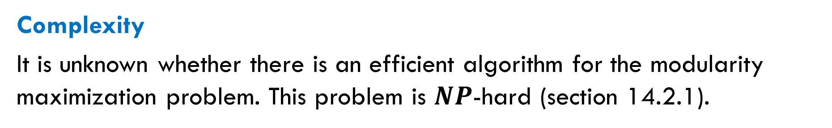
Definition
The modularity maximization problem: given a network, find its partition into communities that maximizes the modularity.
Complexity
It is unknown whether there is an efficient algorithm for the modularity maximization problem. This problem is $NP$-hard (section 14.2.1).
Coping with computational hardness.
Heuristic algorithms, for example greedy algorithms.
Approximation algorithms for modularity approximation.
Randomized algorithms.

Slide 7
Example: Simple Greedy Algorithm
The algorithm below partitions a network into two communities (it can be modified for partitioning into any number of communities).
Start with a random partition into two groups.
For each node, calculate how much the modularity would change if that node were moved to the other group.
Choose a node with the maximum increase of the modularity and move it to the other group.
Repeat steps 2 and 3 until the modularity no longer improves.
Running time: $O(n\left(m+n\right))$, too slow for large $n$.

Slide 8
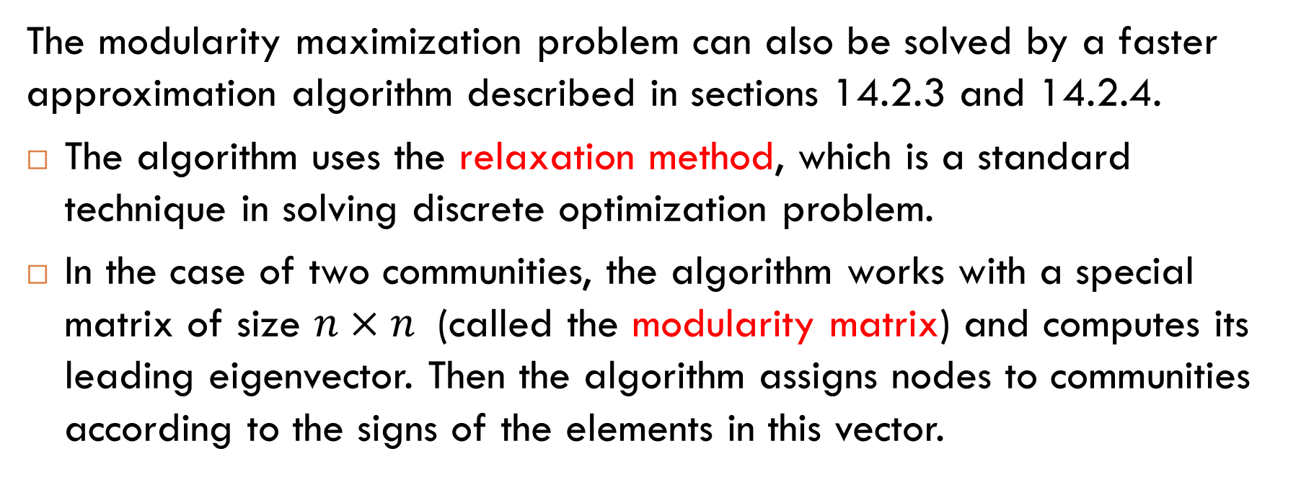
Approximation Algorithm
The modularity maximization problem can also be solved by a faster approximation algorithm described in sections 14.2.3 and 14.2.4.
The algorithm uses the relaxation method, which is a standard technique in solving discrete optimization problem.
In the case of two communities, the algorithm works with a special matrix of size $n×n$ (called the modularity matrix) and computes its leading eigenvector. Then the algorithm assigns nodes to communities according to the signs of the elements in this vector.
Running time: $O((m+n) log n)$, faster than the greedy algorithm.

Slide 9

The Louvain Algorithm
This algorithm (described in section 14.2.5) is an example of so-called “bottom-up” algorithms:
It starts with single-node groups, each node forms its own group.
Then the algorithm merges groups into larger ones. At each step, the algorithm performs a merge that most increases the modularity, and repeats this procedure until no further increase is possible.
Running time: $O\left(\left(m+n\right)log n\right)$. The inventors applied it to a network with more than ${10}^{8}$ nodes and ${10}^{9}$ edges.

Slide 10
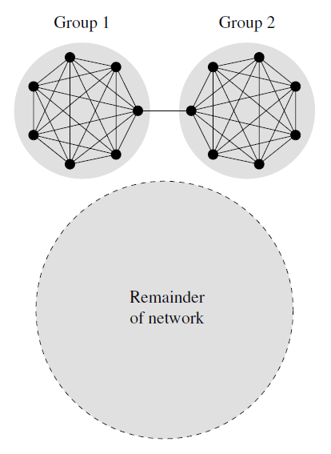
Resolution Limit for Modularity Maximization
Algorithms based on modularity maximization work well in practice and are widely used. However, they have some drawbacks and one of them is a resolution limit.
Resolution limit: an algorithm cannot see communities in a network if they are too small, relative to the size of the network as a whole.
very large compared to Group 1 and Group 2

Slide 11
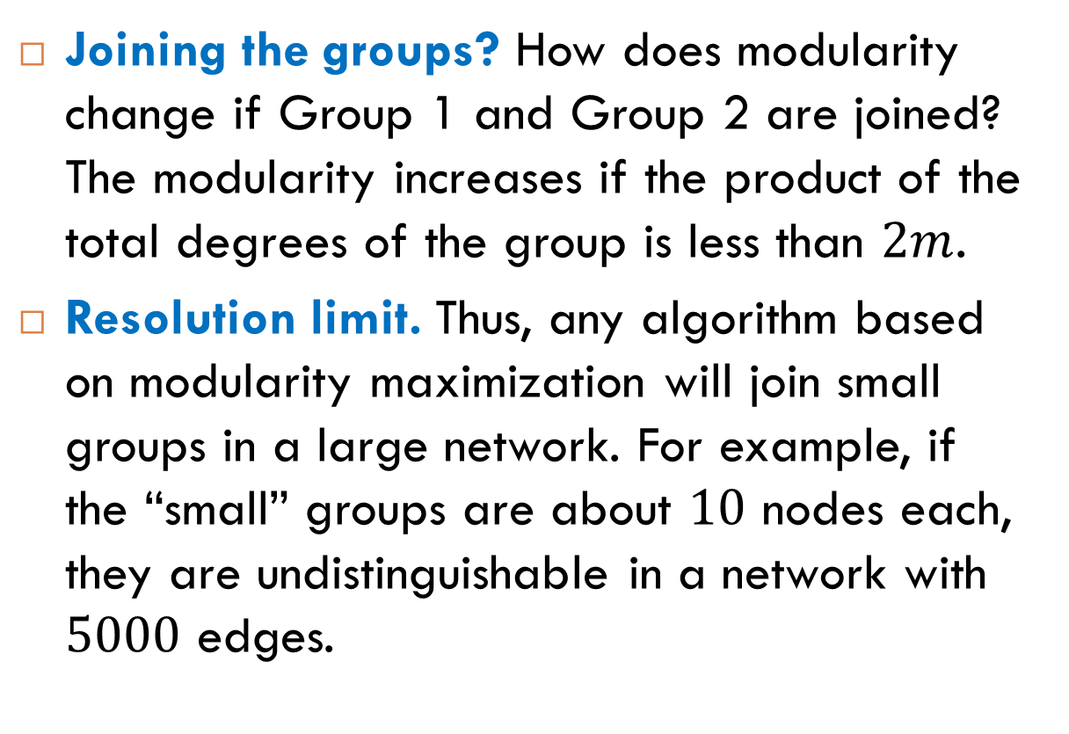
Example
Joining the groups? How does modularity change if Group 1 and Group 2 are joined? The modularity increases if the product of the total degrees of the group is less than $2m$.
Resolution limit. Thus, any algorithm based on modularity maximization will join small groups in a large network. For example, if the “small” groups are about $10$ nodes each, they are undistinguishable in a network with $5000$ edges.
very large compared to Group 1 and Group 2

Slide 12

Reading
Sections 14.1-14.2

Slide 13
Betweenness Clustering

Slide 14
Bridge-Like Links
Idea. A community in a network is an “island”, possibly connected with other “islands” by few “bridges”. We can detect such communities if we identify “bridge-like” edges that lie between them.

Slide 15
Betweenness Again
How to identify bridge-like links? We can use the same idea as in the case of betweenness centrality:
Flows. A network is viewed as a set of nodes connected by paths along which something flows. Natural examples of such flows are information or goods. A flow between two nodes always takes shortest paths between them.
Bridge-like edges. The edge betweenness of an edge (defined in the next slides) measures the total amount of flow that it carries. Edges that lie between communities, called between-community edges, are expected to have high values of the edge betweenness.

Slide 16
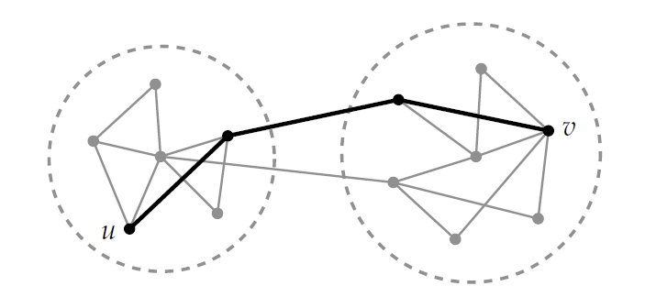
Between-Community Edges
We expect the between-community edges to carry more shortest paths than most. By calculating the edge betweenness of each edge, we can identify the between-community edges.

Slide 17
Definition of Edge Betweenness
Given a graph, the edge betweenness of an edge $e$ is defined by
the number of shortest paths between $u$ and $v$ that contain $e$
$$B_{e} =\sum_{u,v}{\frac{P_{e}(u,v)}{P(u,v)}}$$
the total number of shortest paths between $u$ and $v$
where the sum is taken over all unordered pairs of nodes $(u,v)$ such that $u≠v$. We adopt the convention that the $(u,v)$th term in the sum is zero if $P\left(u,v\right)=0$.

Slide 18
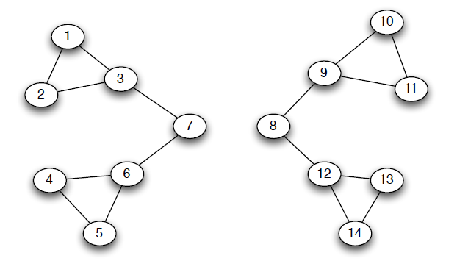
Example
$$3⋅11=33$$
$$1⋅12=12$$
$$7⋅7=49$$
$$1⋅1=1$$
Notes:
The edge betweenness of the edge 7-8 is $49$. Why? The edge betweenness is the sum taken over all pairs of distinct nodes. In this sum, all terms corresponding to pairs of nodes $1,2,…,7$ are $0$. Similarly, for the terms corresponding to pairs of nodes $8,9,…,14$. Only pairs $u,v$ where $u∈\left\{1,2,…,7\right\}$ and $v∈\{8,9,…,14\}$ have nonzero values. Namely, each such term is equal to $1$ because all shortest paths from $\left\{1,2,…,7\right\}$ to $\{8,9,…,14\}$ contain edge 7-8. How many such pairs $u,v$ are there? Clearly, $7⋅7$. The calculations for other edges are similar.

Slide 19
Betweenness Algorithms: General Approach
Calculate the edge betweenness for each edge and remove the edge(s) of highest betweenness from the graph.
This may cause the graph to separate into multiple connected components. If so, the components of the remaining graph are the communities of the first level.
To obtain the next level of community structure, recalculate the edge betweenness for each edge and again remove the edge(s) of highest betweenness.
Repeat step 3 until no edges remain.

Slide 20
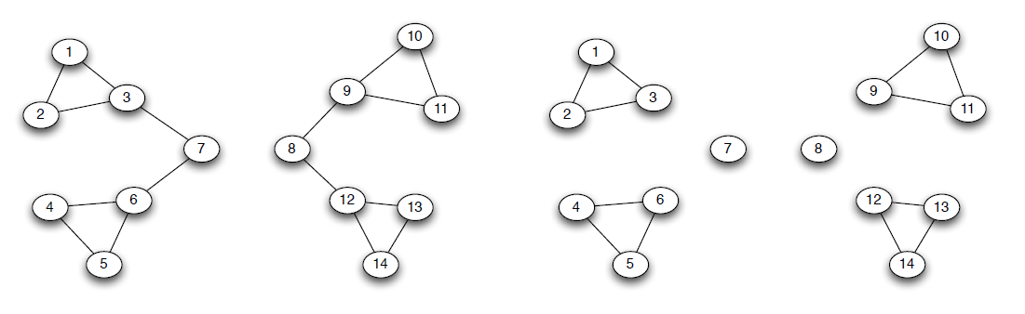
Betweenness Algorithms: Example
Level 1
Level 2

Slide 21
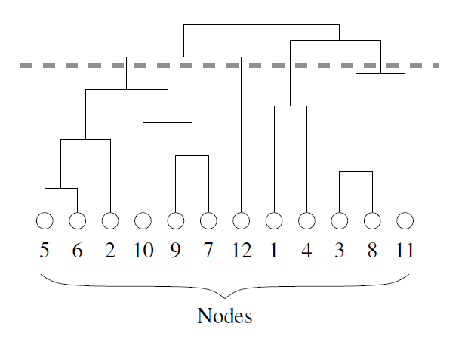
Dendrogram
The result of a betweenness algorithm can be represented using a rooted tree called “dendrogram”. This dendrogram represents the entire network and the leaves represent the nodes.

Slide 22
Calculation of Edge Betweenness
Betweenness algorithms differ in how they calculate edge betweenness. For example, the Girvan-Newman algorithm calculates edge betweenness by performing breadth-first search (BFS) for each node $A$:
Step 1. By working down through the layers, the algorithm determines the number of shortest paths from $A$ to each other node.
Step 2. By working up through the layers, the algorithm uses the numbers of shortest paths to determine the amount of flows from $A$ for each edge.
Step 3. Then the algorithm simply adds up the flows from all nodes to get the edge betweenness on every edge.

Slide 23
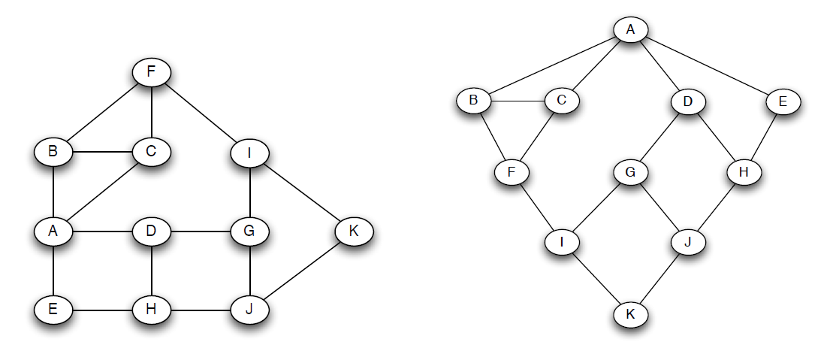
Step 1: BFS Starting at Vertex $A$
BFS starting at $A$
input graph
A detailed explanation of this example in given in the book by Easley and Kleinberg, section 3.6.

Slide 24
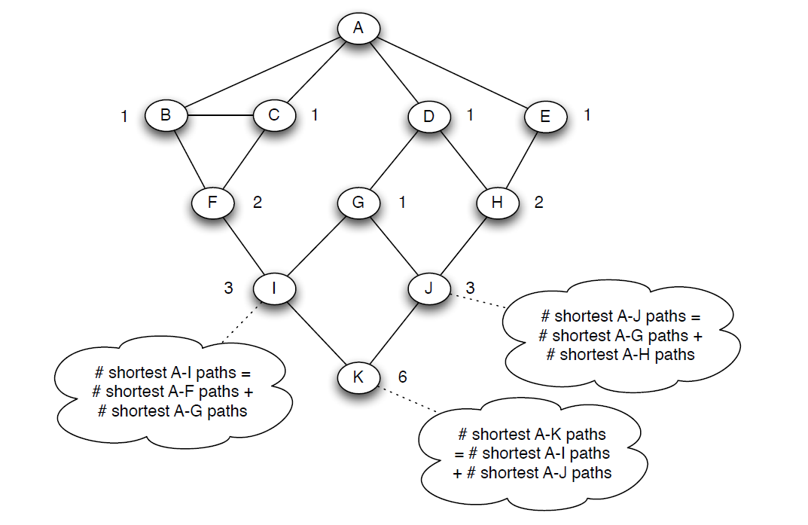
Step 2: Numbers of Shortest Paths

Slide 25
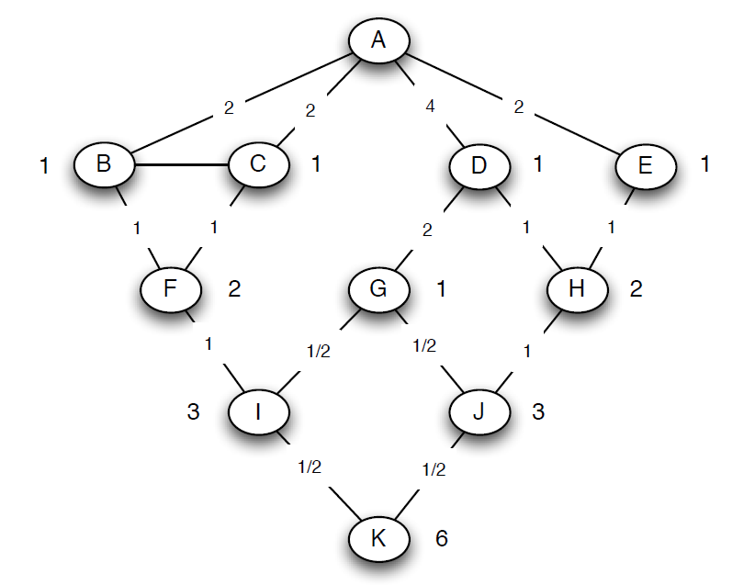
Step 3: Amount of Flow for Every Edge
$1+1$ paths to H, split evenly
$1+0.5$ paths to J, split $1:2$
$1$ path to K, split evenly

Slide 26
Running Time
On a graph with $n$ nodes and $m$ edges, the Girvan-Newman algorithm runs in time
$$O(mn\left(m+n\right))$$
which is $O\left(n^{3}\right)$ for sparse graphs where $m$ is proportional to $n$.
Thus, the Girvan-Newman algorithm is slower than algorithms based on modularity maximization, but it gives quite good results in practice.
Also, betweenness algorithm may be preferable in some applications because they return a dendrogram, rather than a single partition of a network.

Slide 27
Hierarchical Clustering

Slide 28
What Is Hierarchical Clustering?
Basic idea. Hierarchical clustering is a bottom-up approach to the community detection problem in which we start with the individual nodes of a network and join “similar” nodes together to form groups.
Similarity. The key point of this approach is how to define and measure similarity between nodes. Depending on what similarity is chosen, the approach gives different community structures.
Variants of similarity:
Shortest-path distance.
Similarity for nodes represented by rows of the adjacency matrix.
Similarity for nodes represented by their neighborhood subgraphs.

Slide 29
Similarity Between Groups of Nodes
Consider two groups of nodes, containing $n_{1}$ and $n_{2}$ nodes respectively. They form $n_{1}n_{2}$ pairs of nodes.
Single-linkage similarity. The similarity is defined by the most similar of these $n_{1}n_{2}$ pairs of nodes.
Complete-linkage similarity. The similarity is defined by the least similar pair of nodes.
Average-linkage similarity. The similarity is defined by the mean similarity among all $n_{1}n_{2}$ pairs of nodes.

Slide 30
The Hierarchical Clustering Method
Choose a similarity measure and evaluate it for all node pairs.
Assign each node to a group, consisting of just that one node. The similarities of these groups are just the similarities of the nodes.
Find the pair of groups with the highest similarity and join them together into a single group.
Calculate the similarity between the new composite group and all others using the chosen measure.
Repeat from step 3 until all nodes have been joined into a single group.

Slide 31
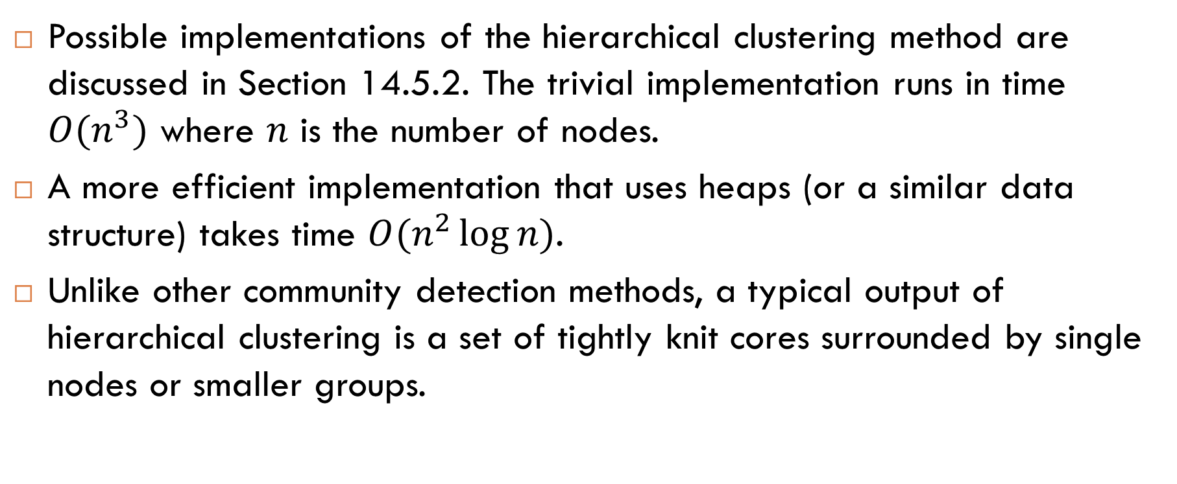
Implementations and Analysis
Possible implementations of the hierarchical clustering method are discussed in Section 14.5.2. The trivial implementation runs in time $O(n^{3})$ where $n$ is the number of nodes.
A more efficient implementation that uses heaps (or a similar data structure) takes time $O(n^{2}\log{n})$.
Unlike other community detection methods, a typical output of hierarchical clustering is a set of tightly knit cores surrounded by single nodes or smaller groups.

Slide 32

Reading
Section 14.5
Section 3.6

